Slide 1
XYZ PLASTICS: RUSSIA
Name:
School:
Professor:
Date:

Slide 2
1. XYZ Plastics: Russia
- Many companies that are eyeing for plastic technology are heading to Russia. The Russian rubber and plastic products are in high demand in Europe. The areas of target being the construction industry, automotive and packaging, and so forth. The Russian Plastic market produces both finishes as well as semi finished plastics for its consumers across Europe and other continents such as North America.
- It is therefore one of the most productive markets in terms of plastics in Russia and my company is going to do quite well there. I expect bring a dynamic range of plastic products that are modernized to meet the market demand across the globe.

Slide 3
2. My chosen international market
- The European international market will be the company’s main target for plastic products that will be manufactured by XYZ company based at Russia. The Russian plastic products have high demand in Europe and they are recognized for good quality.
- For example, Russia is the second highest share in export of plastic and rubber products in Europe according to (EU, 2007). The development of the market and diversification has widened the gap for plastics that is yet to be closed by the supplier in the market and this is a viable opportunity for XYZ Company.

Slide 4
3. Company and Products for the class
-XYZ Company is a profit making enterprise that that is listed as a Public Limited Company operating in a foreign country and a foreign market. The company intends to manufacture different products of different class namely; lightweight plastics, pipes, conventional materials such as cardboard, paper and steel. It is also seeks to manufacture packaging materials that are on high demand in the market.

Slide 5
4. Mode of entry into the new country
- The mode of new entry into the country will involve establishment of the company as a legal identity through certification and licensing processes listed in Russia’s companies Act.
- The business will proceed to leasing off assets that are needed in the start-up process and kick start the manufacturing process. The first produce will be sold to the market at a discounted price that will bring to the attention of the market the products of the company. Mush needed include marketing and advertising through the media. This will keep the customers aware of the companies products and create a group of loyal customers.

Slide 6
5. Market segmentation
-The market has been segmented depending with the market need/benefits, the market geographical location, demographic and behavioral. In other words the market need has been based on the respective industry. For example,
Transport industry that need tires
Toy industry for kids
Buyer readiness i.e. behavioral
The manufacturing industry that need packaging materials to package their produce
Lifestyle e.g. for companies making cosmetics

Slide 7
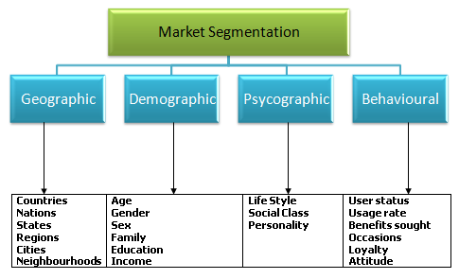
5. Market segmentation

Slide 8
6. Market description
The European market is dynamic in nature with a lot of automotive industry developments. The packaging industry is on its peak in Russia. The increasing number of investments in Russia and more so in the domestic food industry demand for customized plastic products for packaging and manufacturing of their products.
- The secondary target market has a good population and the GDP is good for a business venture into the market. the market gap for plastic products is still not yet fully covered thus there is high demand for the plastics products.

Slide 9
7. Marketing mix
-In order to adapt to the marketing mix, XYZ Company will settle for 4P’s in order to establish a market advantage in both the secondary and primary markets. This includes;
The fair prices for our products, discounts and so forth will be needed.
Promotion of the company’s products e.g. through discounts
Product differentiation though design, marketing and advertising
Placing of the market in the market to capture the buyer. This will need a good supply chain that will effectively place the product in the market at the right time (Product positioning).

Slide 10
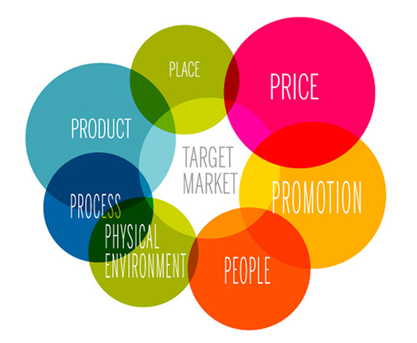
7. Marketing mix

Slide 11
8. Human Resource management
-The Human Resource will have to look into the following key areas
Training of the staff
The staff e.g. marketing team will need the skill necessary for selling XYZ products in the market and this calls for training
2. Rewarding employees
Employees who perform well in their responsibilities need to be rewarded e.g. salary increment
3. Recruiting the right personnel who are able to execute their mandate effectively

Slide 12
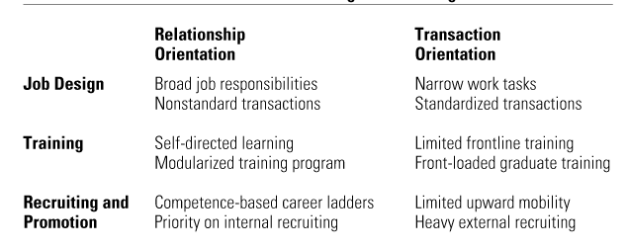
Human Resource management table

Slide 13
9. Staffing framework
The staffing framework that will be needed include;
1. comprehending the context of the business on long term basis
2. defining the roles of each staff member
3. The specification of necessary staffing actions and plans
4. The implementation and establishment of the staffing plans

Slide 14
10. Position to be filled (Marketing Manager)
Responsibilities of the manager include;
1. Marketing of the company’s products
2. Conducting market research.
3. Establish and train the marketing team
4. Liaising with media organizations to advertise the business and products
Marketing manager job qualifications
1. bachelor degree in marketing or any related business field
2. Experience of less than five years in marketing management
3. Budget management skills
Salary and remuneration
. $20,000

Slide 15
Reflection
Armstrong, K. A., & Bulmer, S. (2015). The governance of the single European market. Manchester [u.a.: Manchester Univ. Press.
Barnard, C., & Scott, J. (2012). The law of the single European market: Unpacking the premises. Oxford: Hart.
IBP, I. N. C. (2016). RUSSIA EXPORT-IMPORT AND BUSINESS DIRECTORY VOLUME 2 MAJOR EXPORT-IMPORT AND TRADING COMPANIES IN... REGIONS. S.l.: LULU COM.
Rona-Tas, A., & Guseva, A. (2014). Plastic money: Constructing markets for credit cards in eight postcommunist countries.

Slide 16
END
I welcome questions from the audience.

